Slide 1
Improving memory locality in seismic simulations on video cards
Schmidt László Computer engineering BSc
Supervisor : Dr. Reguly István Zoltán

Slide 2
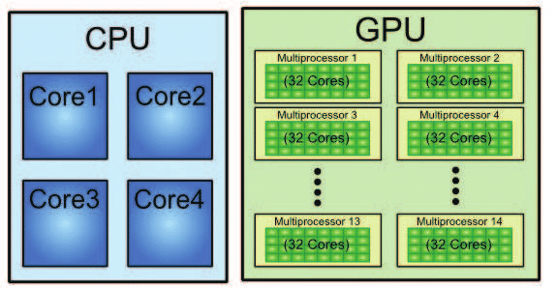
Motivation
CPU clock reached upper limit.
Trends have shifted towards multithreading
Multi-core CPUs
GPUs can run many parallel threads
Linearly increasing computing capacity

Slide 3
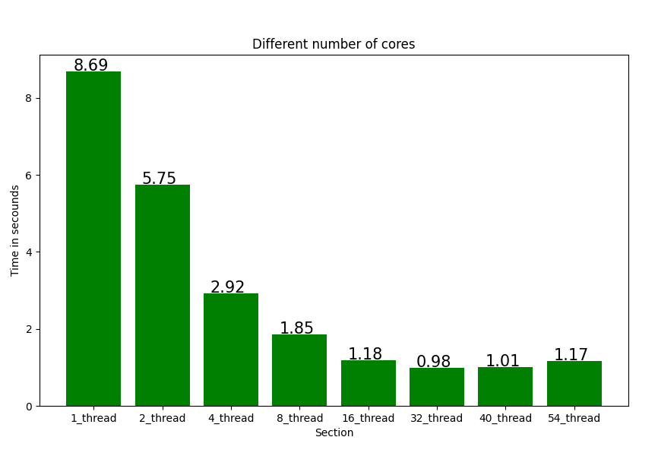
Parallel
Parallel programming
some instruction can be executed on different CPU core at the same time
Huge initial acceleration, but memory bottlenecks show up quickly.

Slide 4
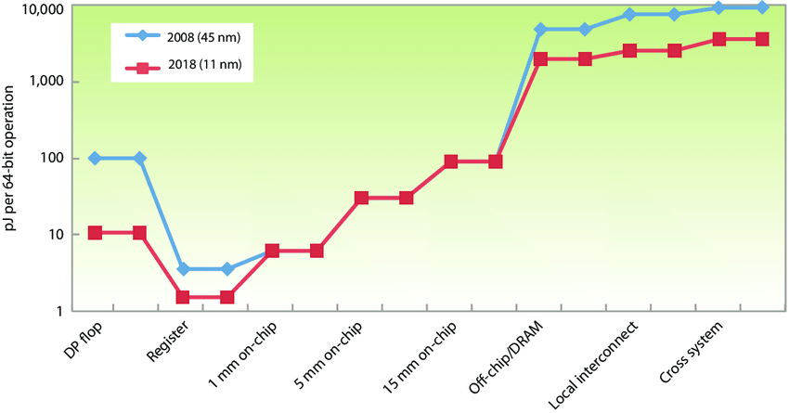
Data movement
The instruction and data must be in the registers
Moving data costs a lot of energy
The farther we want to move it from, the more expensive it is
Reduce the number of expensive operations

Slide 5
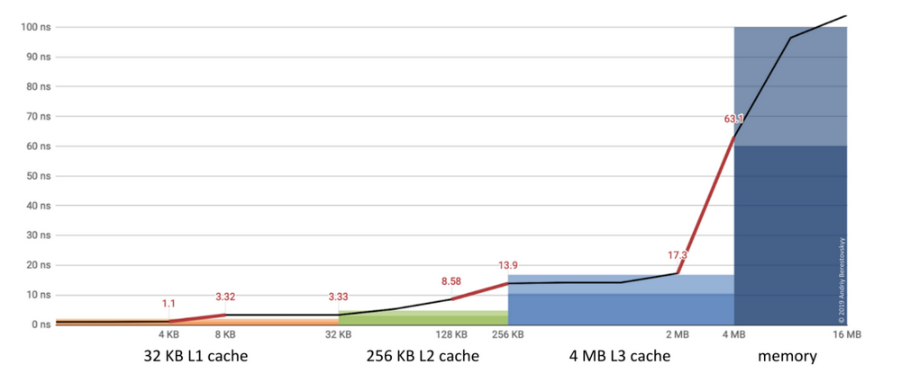
Delay of Memory hierarch

Slide 6
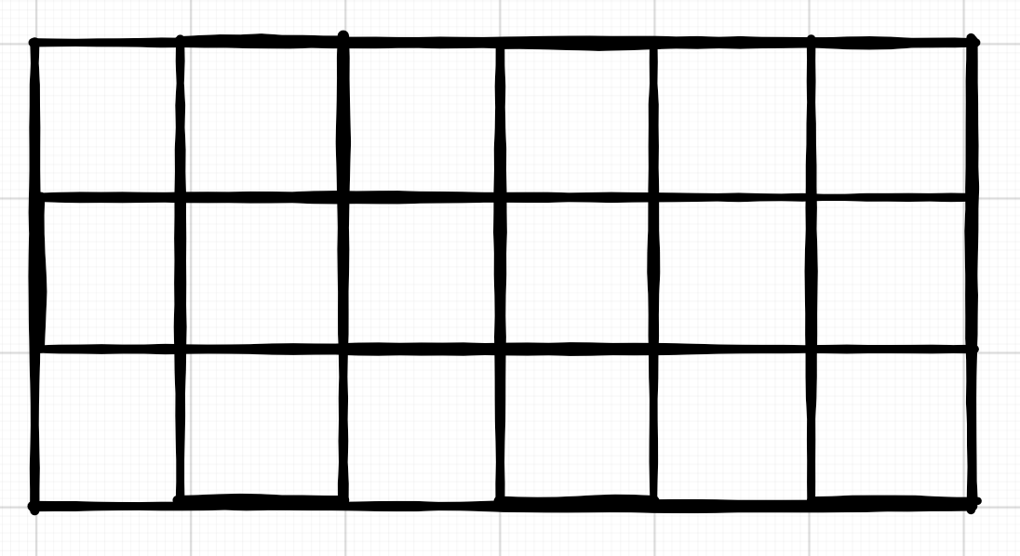
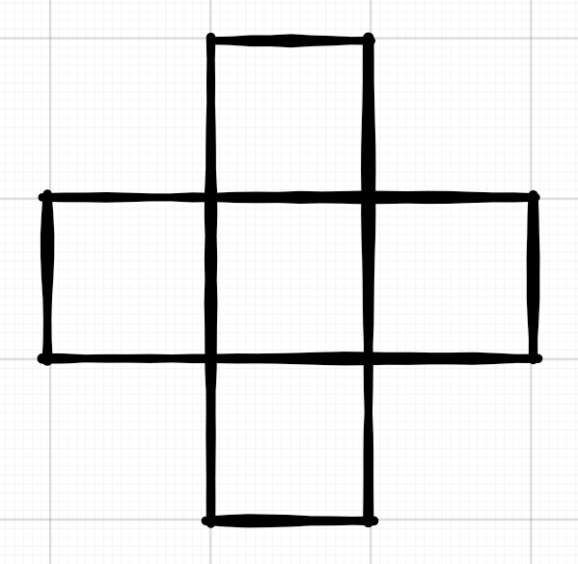
Cross example
4 x 5 = 20
14 load
1
1
1
1
1
2
3
3
2
1
1
1
1
1

Slide 7
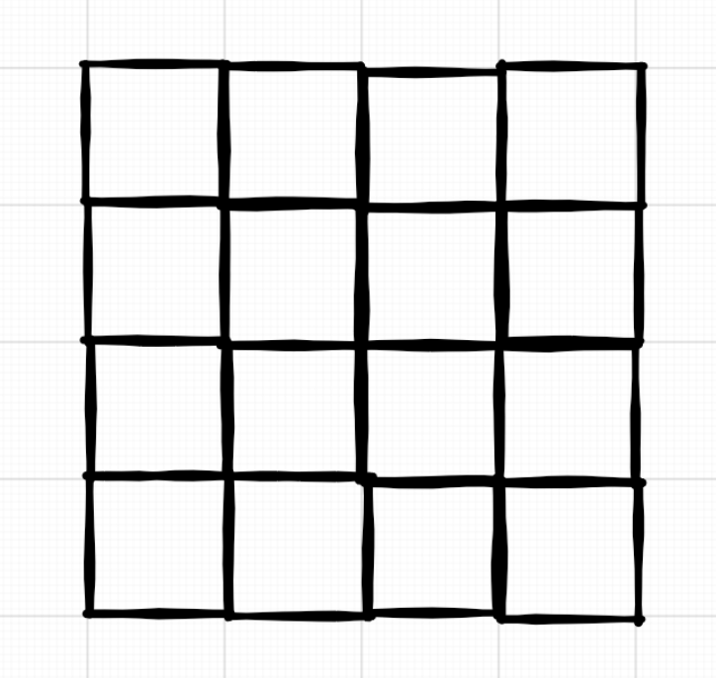
Cross example with blocking
4x5=20 point
12 load
1
1
1
3
3
1
1
3
3
1
1
1

Slide 8
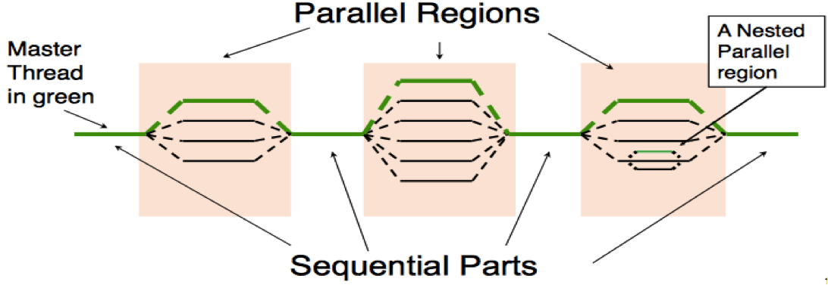
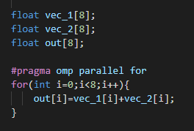
OpenMP C/C++
Open Multi-Processing
Compile time optimization
Pragmas - message to the compiler
It implements the steps of parallelization
Supports Video Cards
Simple and widespread
https://docs.nersc.gov/development/programming-models/openmp/openmp-resources/

Slide 9
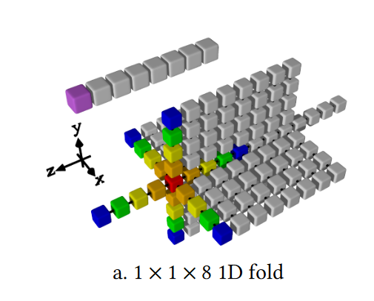
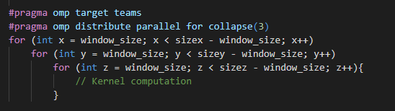
3D cross example
Memory locality problem
Lot of points only loaded once
Target teams = GPU
Distribute = among GPU threads
Iterations executed on a gpu

Slide 10
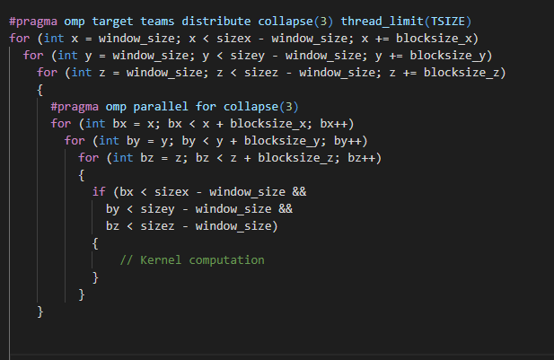
Loop/Thread/Cache Blocking
Simple implementation on CPU, already widespread
It is not entirely clear in OpenMP
Changing the order of iterations
Team and Thread
Not yet supported in stable compiler versions

Slide 11
Cross results GPU:Nvidia V100
Naive (default) case 128x1x1 block size
The best case is the block size 8x4x32
Better cache utilization
Less waiting on data
 | Global Hit Rate | Global Load Throughput | Device Memory Read Throughput | L2 Throughput (Reads)
Naive | 36.43% | 1113.80GB/s | 488.21GB/s | 799.30GB/s
Tiled | 71.86% | 1849.00GB/s | 310.39GB/s | 476.74GB/s
improvement | 97% | 66% | 36% | 40%

Slide 12
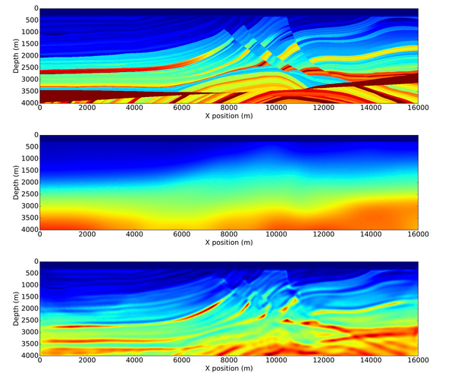
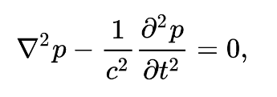
Devito
Domain Specific Language (DSL)
Partial differential equations
Python
Compiles to C
OpenMP optimization
Example of sound wave propagation
Seismic Inversion using Devito

Slide 13
Devito results GPU:Nvidia V100
Sound wave propagation in 600 ^ 3 space
In a naive case, as the neighbors number grows the time worsens
Tiling improves optimization
 | SO 4 | SO 8 | SO 16
128x1x1 | 11.9 | 19.31 | 40.15
16x4x32 | 8.24 | 10.85 | 16.39
Speedup | 1.44 | 1.77 | 2.44

Slide 14
Devito results GPU:AMD MI50
There is no such improvement
Compiler still under development
 | SO 4 | SO 8 | SO 16
Naive | 19.65 | 32.45 | 77.29
Tiled | 17.95 | 27.16 | 70.73
Speedup | 1.094 | 1.194 | 1.092

Slide 15
Summary
I showed On structured data for neighborhood calculations, how to increase memory locality.
A method for this has been developed in an openMP environment that also works on a GPU.
And I have shown that this can be applied not only to simple examples but also to complex applications (Devito)
On Nvidia and AMD graphics cards.
Works with multiple equations.
This allows devito users to achieve 1.1-2.5x speedup.
As a continuation of my work, I will implement this optimization in the Devito code generation process.

